Slide 1

Simple Training Process for Volunteers Using Steps
Notes:
Let’s get started. You are in the session, Simple Training Process for Volunteers Using Steps. This is a beginner level class that shows you a basic setup to start using that will help track volunteers as they go through a number of steps for a training process.

Slide 2
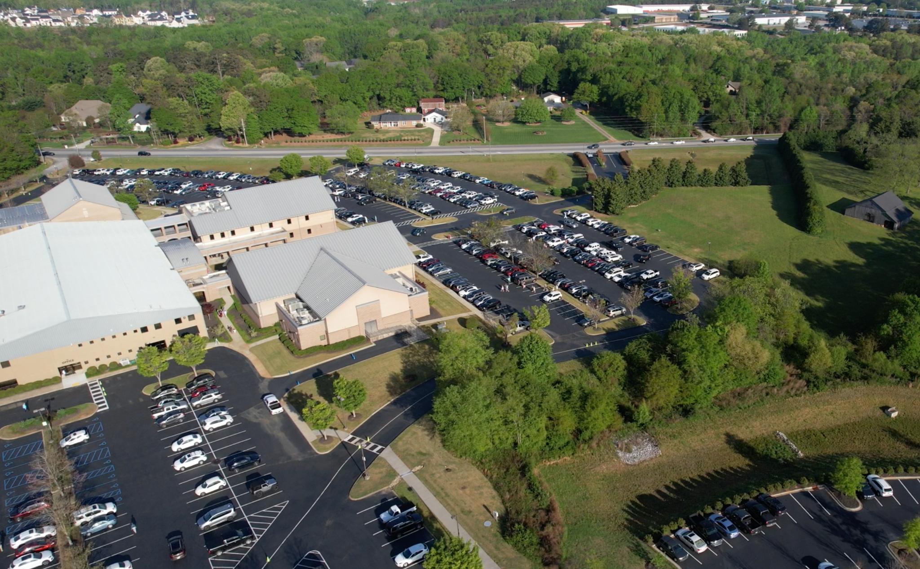
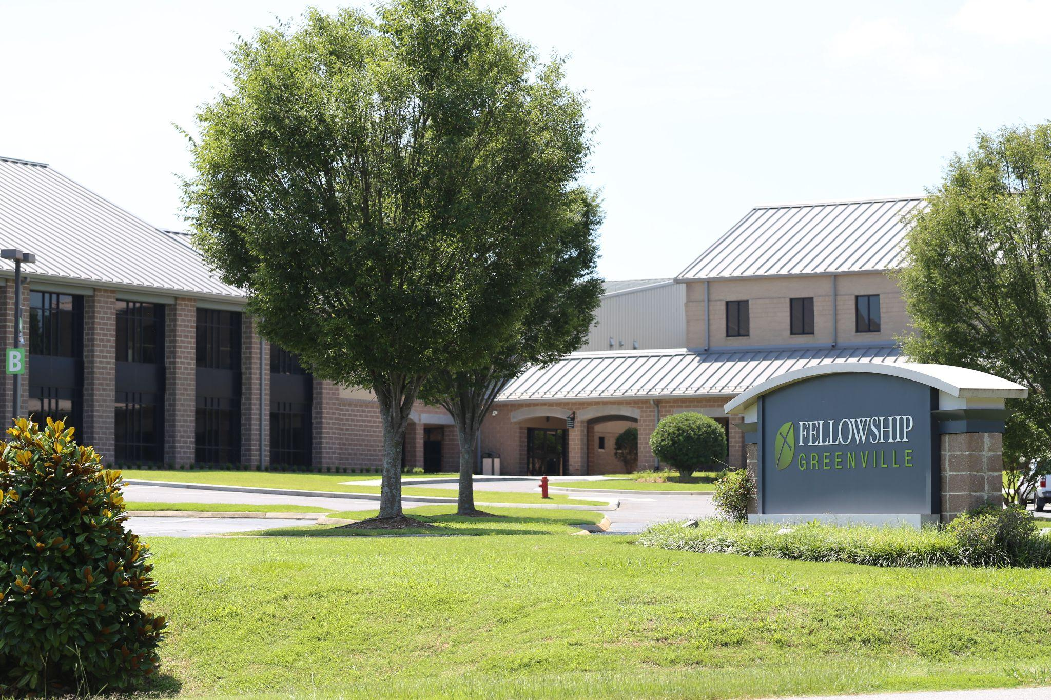

Notes:
I am Tiffany Bunney, IT Senior Support Specialist at Fellowship Greenville. A little about my church, Fellowship Greenville: we are located in Greenville, South Carolina. We are currently a one large-campus church on 25 acres, but we are in the process of building a second 25-acre campus, so we are excited. We currently run around 3000 on Sunday mornings, and have grown over 900 people in the past year and a half. The Lord has really blessed us, and Rock has helped us build systems that make ministry more efficient as we grow. We have been on Rock since 2017.

Slide 3
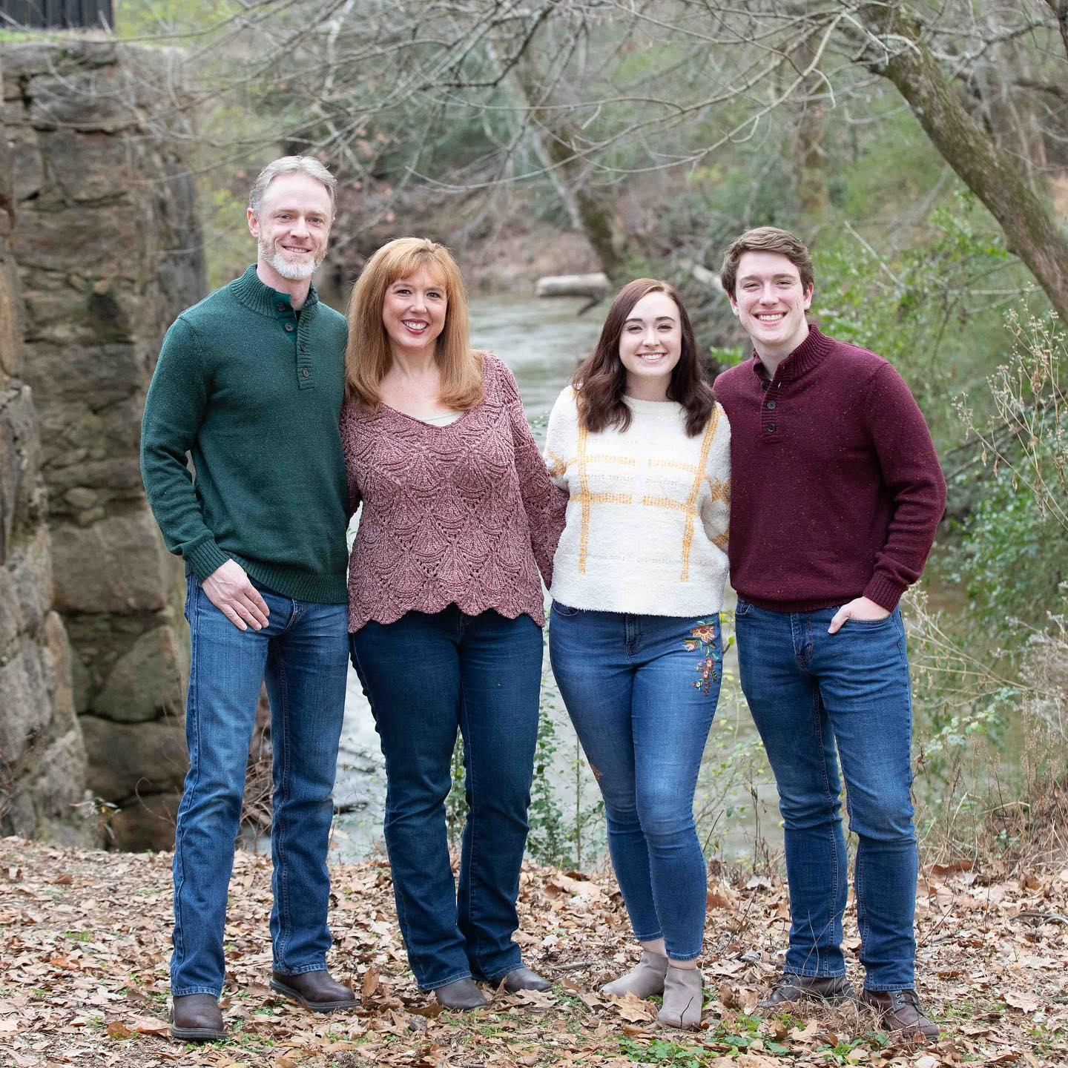
TIFFANY BUNNEY
IT Senior Support Specialist
Notes:
A little more about me: I have been married 25 years to my husband, Josh, and have two grown children, my daughter is a teacher, and my son is in college studying to be a pastor. I am extremely proud of them both! A little about my Rock background: as I said, our church has used Rock since 2017, and I was part of the implementation team. At that time, I was really focused on groups, registrations, and checkin. Since then I have learned most of the aspects of Rock, I say most, because there is a lot to Rock. I am currently the Rock Admin on our staff.

Slide 4
For more information
TIFFANY BUNNEY
tbunney@fellowshipgreenville.org
Rocket.Chat: @tbunney
All resources found here: https://github.com/fellowship-greenville/trainingsteps
Notes:
I wanted you to know before I start that all of these sessions, that these resources are available via our Fellowship Greenville github link. These resources also includes my assistance if you would like to develop a similar system. I would love to set a meeting with you and help you implement this, if you need any help at all!

Slide 5

Notes:
The whole goal of using Rock to streamline processes is for the church to have success in ministry. That is my goal as a Rock administrator and that is how I approach most of our challenges that are presented on a daily basis. Today I am going to show you a simple training process that I came up with that helped our student ministry with one of their challenges.

Slide 6

The Challenge:
When a new person starts serving, it is hard to keep up with where that person is in regards to the onboarding videos they need to watch, or documents they need to read.
Notes:
In our student ministry, the team had a number of videos that their volunteers needed to watch when they were first onboarding their volunteers. Their ministry admin had documents and notes that told her where each person was in the process, but it was difficult to really know quickly where each individual was in the process. When you have over 50 volunteers involved, and each one at a different point in the process, it became quite complicated to keep up with.

Slide 7

Something that is automated
A tool that can be sent from a connection request
Tools that are easily accessible to the ministry
Easy to see snapshot of where that person is
Notes:
The student ministry had some criteria that they wanted to meet, if possible. Their goal was to have something that was automated, so the admin wouldn’t have to be a middleman sending out each step. Also, since most of our serving requests come in from the website in the form of a connection request, they wanted to be able to launch the process from there. Of course, they wanted tools that are easily accessible to anyone in their ministry, in case this had to be passed between a number of people. The last thing they wanted was to be able to quickly see where that person was currently at in the process. That quick snapshot should be captured somewhere on the person record, if possible.

Slide 8

Workflow from a Connection request
Automate which videos the person has completed, and still needs to complete
Mark steps complete when finished
Notes:
I had to go back to my desk and really think of the best solution for the student ministry team. As a Rock admin and member of the IT team, I always want to find a solution within Rock. One of the reasons is that the staff is already very familiar with the tool, so they do not have to learn a new system. Steps had just become a new feature at the time I built this, so I was still learning how to use them. I decided we would need to build two workflows. The first workflow would be used to watch the videos and then send the next step to the person, and the second one was just a manual workflow from a Connection request that would launch the first workflow. We would also add the element of marking steps on a person’s record complete, once they were done with a step.

Slide 9
The Tools You Need
Connection Requests
Workflows
Steps
Lava Shortcodes
Notes:
Everything you need is already in the core features of Rock. I already talked about connection requests, workflows, and steps. I added the lava shortcodes in here because we use the YouTube shortcode for each of the videos. It is just a small use of a powerful tool, but it is how I started using them and became more familiar with them. There is advantage to using a small piece of a powerful tool, as you can figure out some of the aspects of how it works, but not have to be too technical in the beginning. Just a suggestion to all of you from my personal experience.

Slide 10

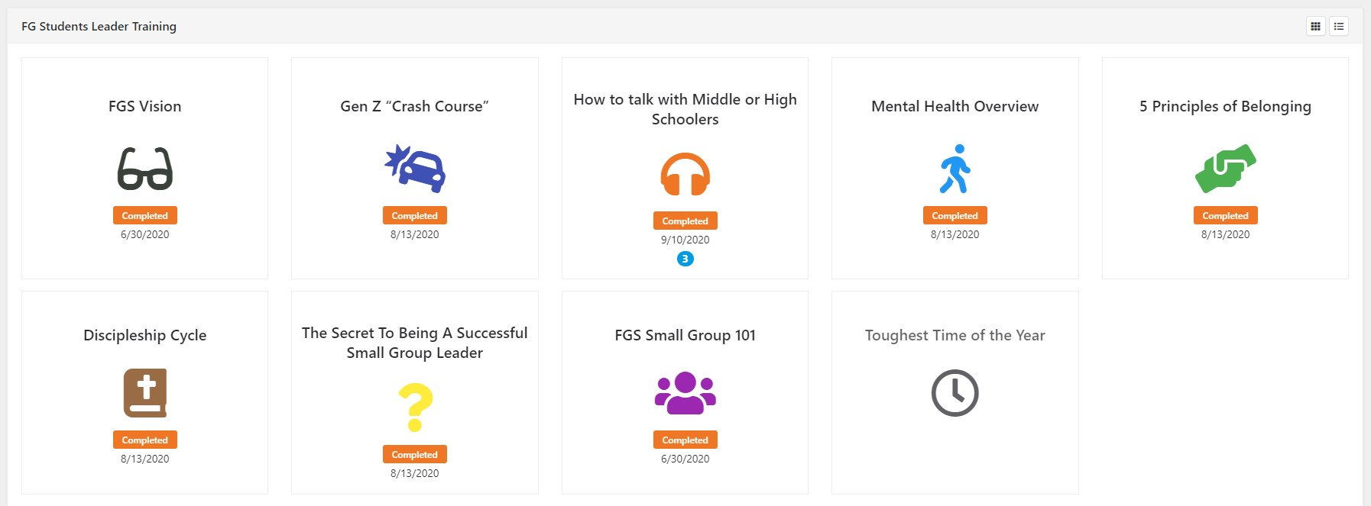
1. Set up Step Program
Notes:
Now, let’s get into the weeds of how to build this, or as I like to call it, the Recipe.
The first thing we did was to set up the Step program that will show anyone who lands on the profile where the person is in the process. Here is the finished product.

Slide 11
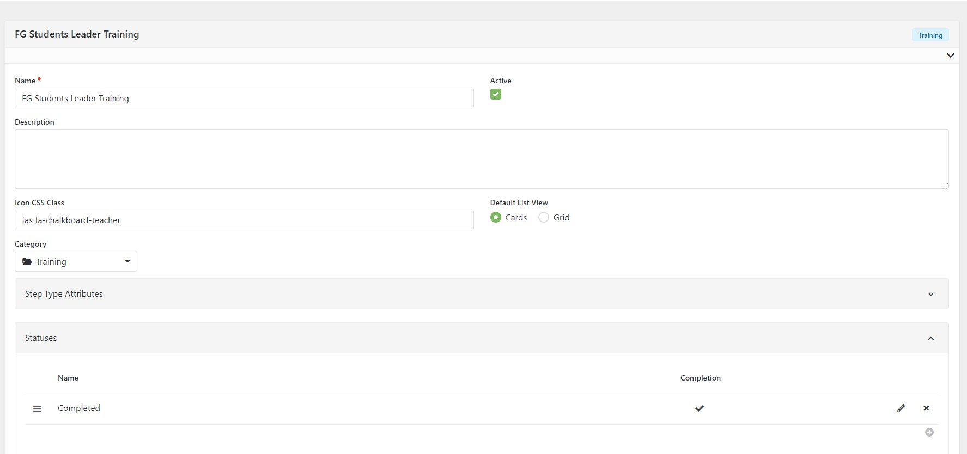
1. Set up Step Program (cont.)
Notes:
The reason that I set the step program up first is because when I start building a workflow, I want everything ready for me. You will need to get the step ids for your workflow, so you need to get the step program and individual steps built before you can build that workflow action.
On this step program you will add the name, category, and set the default list view. We always set ours to cards, as it is a nicer view of the snapshot they wish to see. I will show that to you in a minute. You will also need to set up status, whether In Progress, Completed, or whatever you need for your steps. I only have a status of Completed as they are just watching the video and then it marks it complete. There isn’t any other status needed.

Slide 12
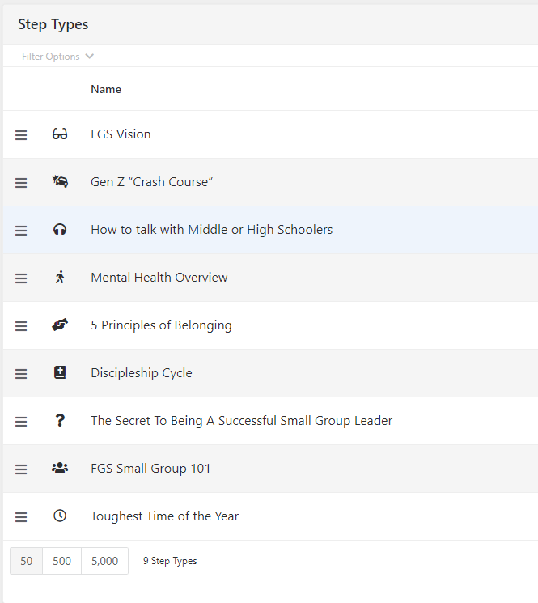
2. Set up Step Types
Notes:
Under the Step Program, you will create the individual steps or step types. You can have as many steps as you need in a step program.

Slide 13
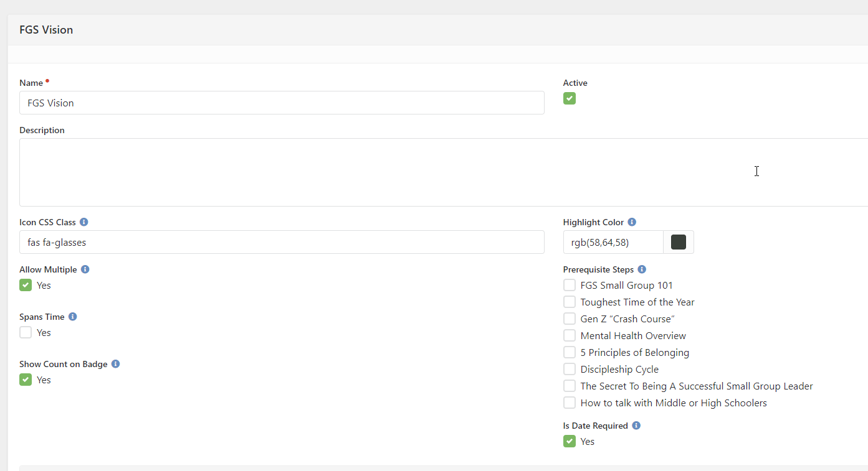
3. Step Type Details
Notes:
For each step type you add, you will fill in the details. This is where you can add the icon and color for the card view, but you can also allow multiples, if you want them to complete this step more than once. You can show the count on the badge, so you can see how many times it was completed, and you can make a date required or not. The date does help you keep track of when it was completed. One more important thing that you can do in this setup is that you can have prerequisite steps that need to be completed before they can complete this step. I don’t have any marked, as the FGS Vision step is the first one in this step program, but subsequent steps can have the FGS vision step as a prerequisite, as this need to be viewed first.
Another example of the use of prerequisites, is played out in membership. We require a person to go through a membership class before the have a membership interview. The class step would be a prerequisite to the interview step. The one problem with prerequisites come if you try to add all the information in manually. You need to add it in the order of prerequisites so you don’t get a message stating that someone has to complete another step first. Just wanted to mention that here as something to be aware of.

Slide 14
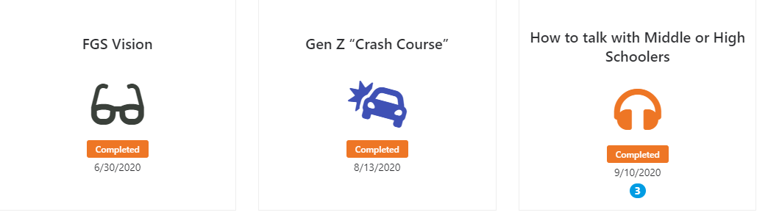
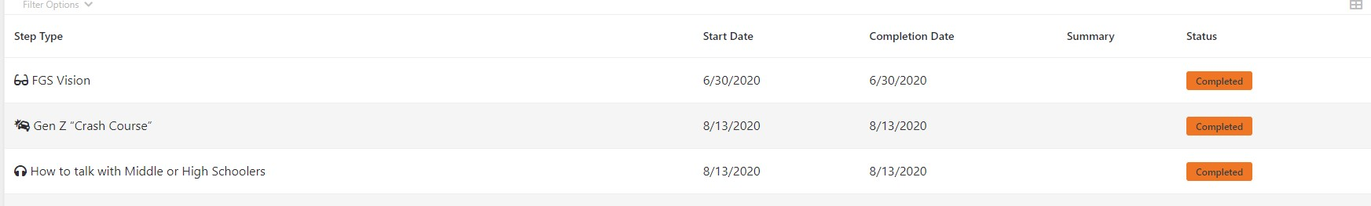
Step Type Default List Views - Card vs Grid
Notes:
This is the default list view that I was talking about, which is located on a person’s profile. This is what the admins will use most of the time. The top one, which is the card view, is much more pleasing to the eye than the bottom, which is the grid view, so it is really up to you which one you would like to use. The grid view does show the start date and the summary, if you have one, so if you need that, then that choice might be more helpful. You also can toggle back and forth between the list and card to see what works best for you.

Slide 15
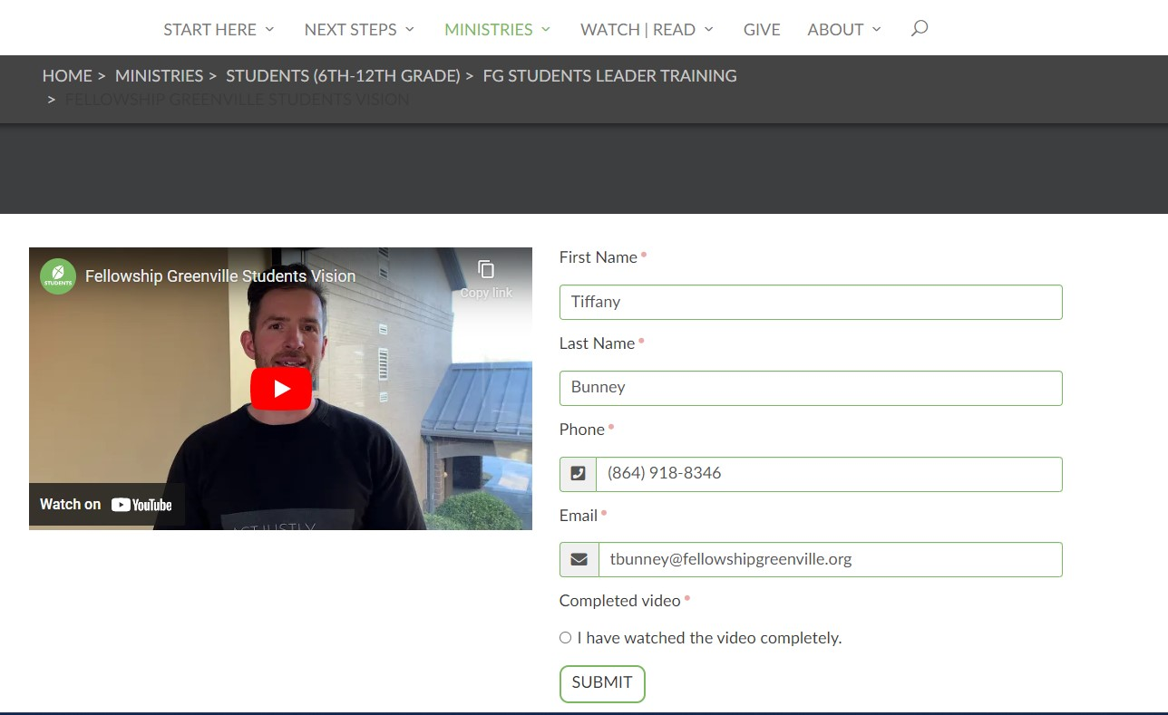
4. Set up pages to place videos
Lava shortcode for video
Workflow form
Notes:
Next I set up the pages for each one of the videos. I placed the video with the YouTube shortcode on the left side of a 2 column layout, and then placed a workflow that asks for their name, phone, and email. I also added a single-select option that says “I have watched the video completely.” The reason I ask for all those fields is so I can use a person lookup to mark the step on their record. You might be asking why we don’t have a program that marks whether someone watched the video or not, and that is simple, we didn’t want to pay for it. Yes, someone could not watch the video and fill out the workflow, but we are trusting our volunteers to be honorable by marking that they have have watched the video all the way through. We were trying to keep the system we used at no cost to our organization, and also as simple as possible, when we built these. Another thing to note, we used videos for this whole process, but you can place content to read and sign as a part of your workflow. It can work a number of ways.

Slide 16
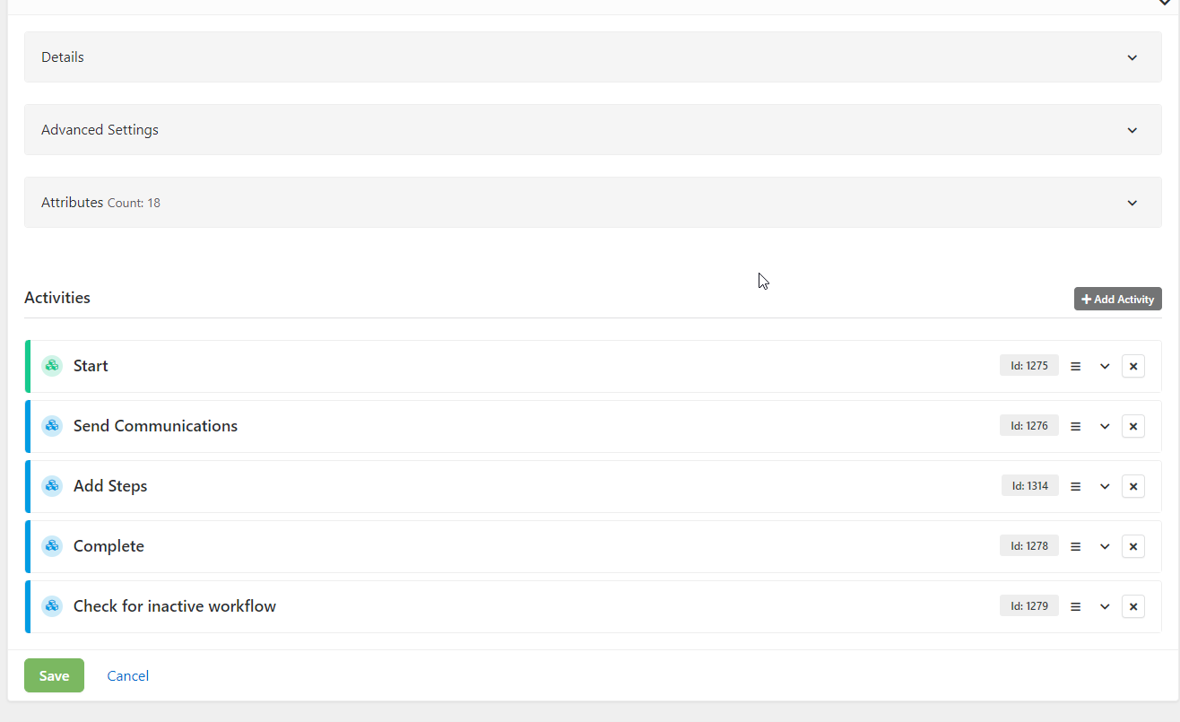
5. Create Training workflow
Notes:
Now, we are going to jump into the workflow itself. Ours is not a very large workflow, as we only have 7 steps, but you can build it as large or as small as you need it. It is really simple and flexible. The only attributes we built were the person attributes for the person lookup, page number, and date attributes for each of the videos that were to be viewed, so we can populate those within the workflow.

Slide 17
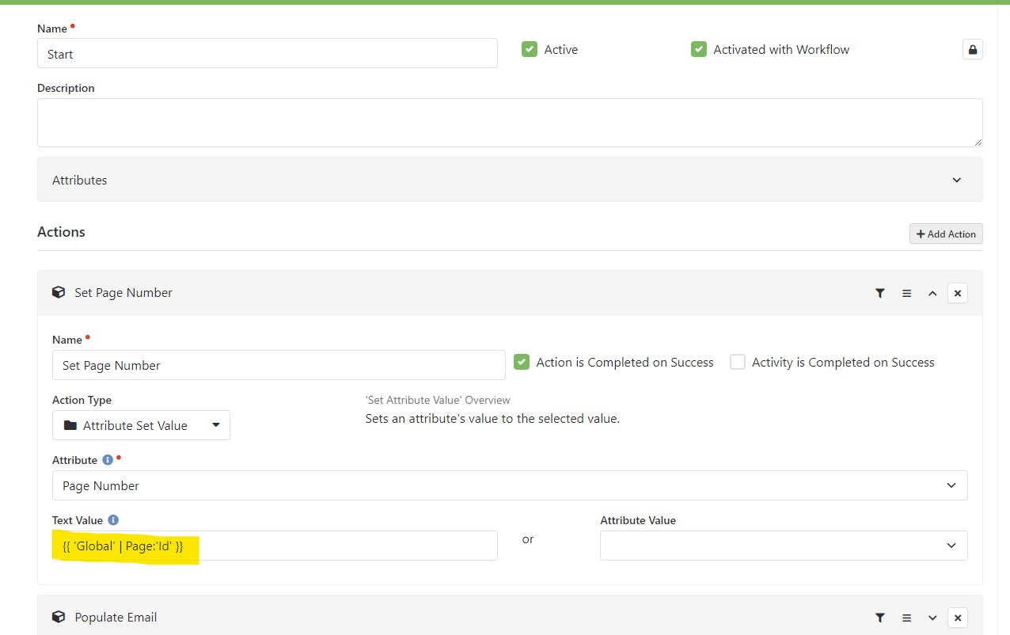
6. Workflow - Filter by page number
{{ 'Global' | Page:'Id' }}
Notes:
The very first thing we did was to set the page number. This is going to be used to filter which video the person watched, and by using the page parameter, the workflow will send the next step of the process to the volunteer. We used an Attribute Set Value action type and then set the page number by the Global Attribute of Page Id. I tried to highlight that on the screen and add it on the right-hand side, so you could see the text value we used.

Slide 18
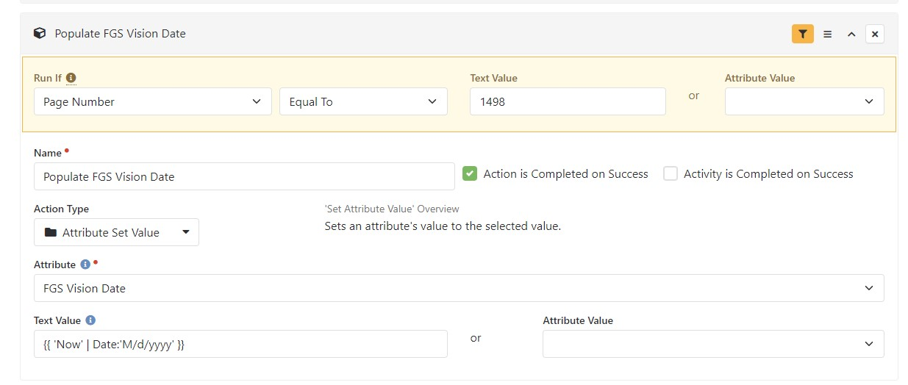
7. Workflow - Populate Date for Video
Notes:
For each of the training videos we wanted to capture the date of when it was watched. We used the page number here as the filter, so we know which date attribute we wanted to populate. For example, in this slide, the page number is 1498, which is the FGS Vision video. Since the page number is 1498, the workflow will populate the FGS Vision Date attribute to today’s date. This date will be used on the step program, so that is why we want to capture it.

Slide 19
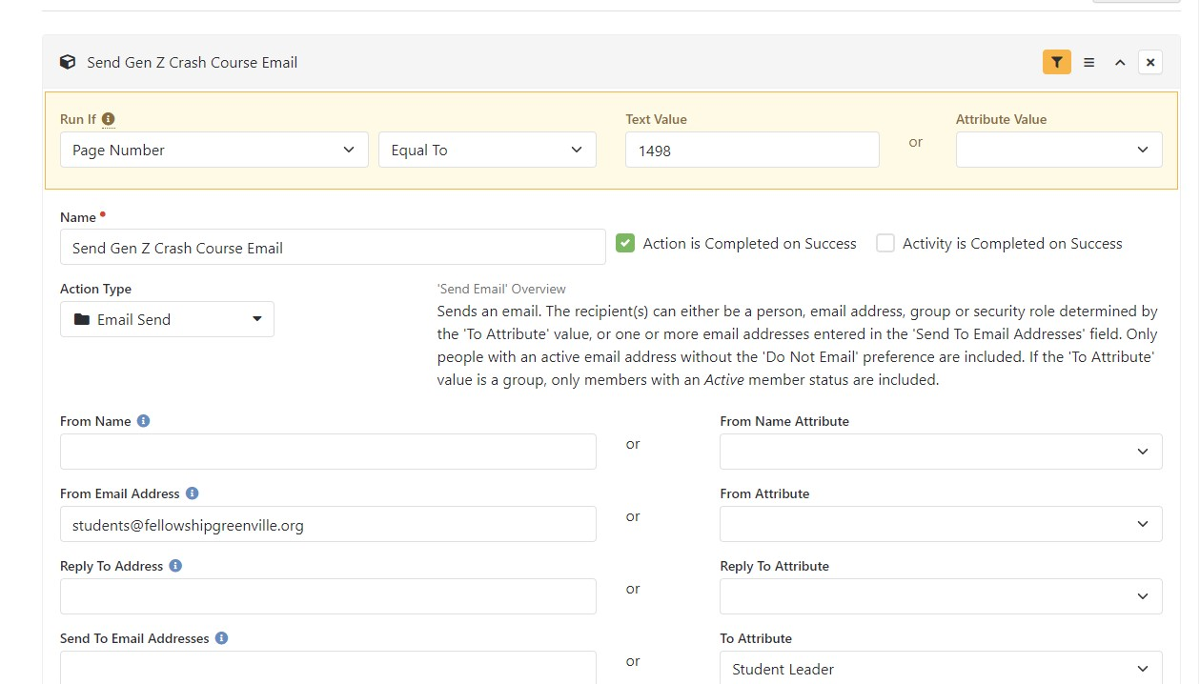
8. Send Email Notifications
Notes:
I also used the page number filter to send email notifications, as I said before. As a person completes a video and fills out the form, the system will automatically see which page number they are on, and then will send the email that goes along with it.

Slide 20
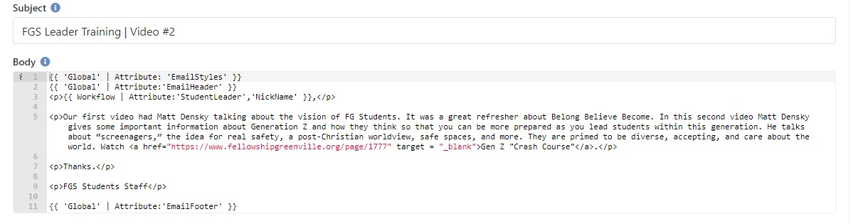
8. Send Email Notifications (continued)
Notes:
This person completed Video 1, so the system will send the email for Video 2. The email reviews the video they just watched, and then explains a little bit about the second video. It also gives them the link to the next video. Each email is set up in a similar fashion. The volunteer gets the emails as they complete the steps, so they can work as slow or as fast as they want. The workflow is designed to complete after each video, so you don’t have a lot of workflows sitting open for long periods of time, which helps efficiency of your database. A new workflow is launched each time someone starts a new video.

Slide 21
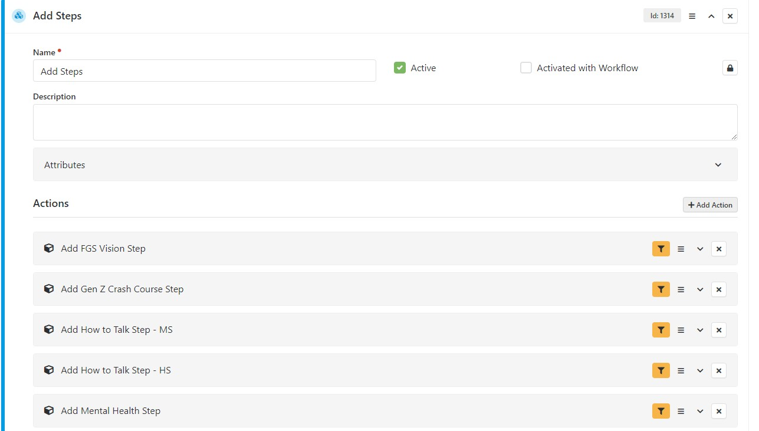
9. Add Steps to Person Record
Notes:
Next, we built an activity where we marked the steps completed as the person watched the videos. This is why we built the step program before the workflow, so we would have this for the workflow to mark completed steps.

Slide 22
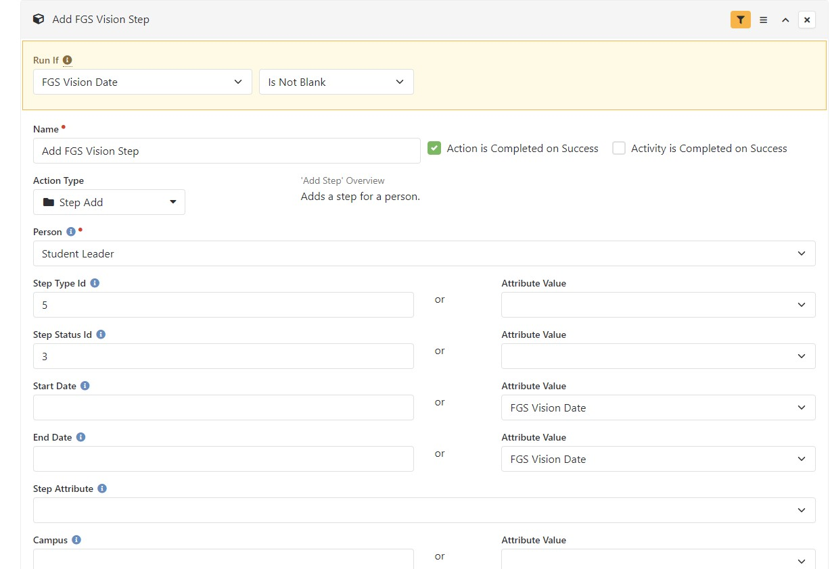
9. Add Steps to Person Record (continued)
Notes:
We first filter on whether the date attribute for that video is blank or not. Then you use the Step Add action type for this. You set the volunteer as the person whose record is going to record the step, then you have to find the Step Type Id, which can be found in the URL when you go to that step in Rock. The hardest thing to find is the step status id. This is where a little bit of SQL is convenient, but if you don’t have that skill, I have added the code to the next slide. The last thing you set is the Start Date and End Date. I used the same date attribute for this, as they basically watch a 5 minute video, so they are completing it the same day they started it. The End Date is what will be used for the Completed date on the step.

Slide 23
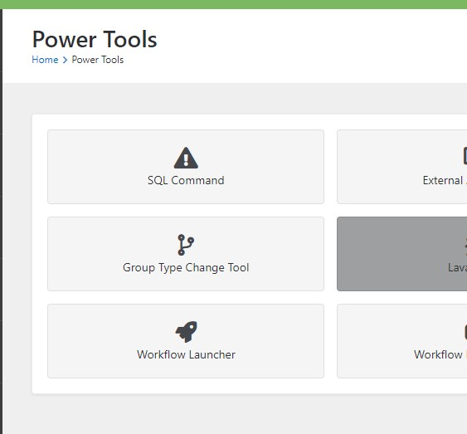
SQL to find Step Status
Select
t.Name as [Step Type Name],
s.Id as [Step Status Id],
s.Name as [Step Status Name]
From
StepType as t LEFT OUTER JOIN StepStatus as s
ON t.StepProgramId = s.StepProgramId
Notes:
This is the SQL code to find the step status id to plug into the workflow. This has been added to our github resources for you to grab. You can run a SQL query in Rock. You would go to Power Tools and choose SQL command. Just remember to be careful if you are in your production environment, and not a test environment, as you don’t want to mess up anything in your database.

Slide 24
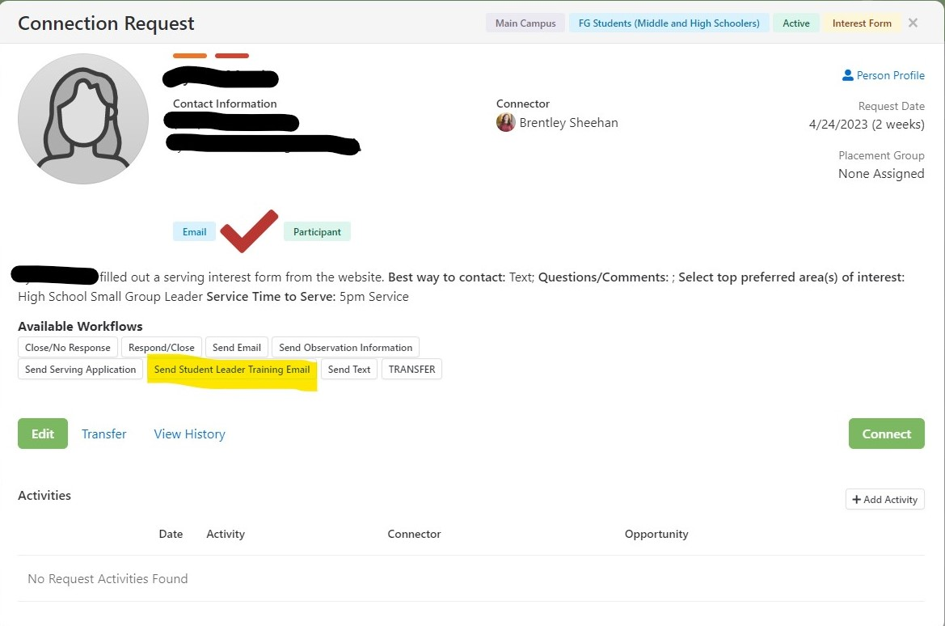
5. Create Connection Request workflow
Notes:
We wanted to be able to send this workflow from a Connection request, so I created a short workflow that let’s the connector send an email that gives the volunteer the first page of the training program. Once they start the training, then the process will proceed with the volunteer getting each email as they complete each video, like I spoke about previously. I have added both of these workflows in our github resources, so you can import them into your database and tweak them as needed.

Slide 25
What if you want to send this training to a large group of people as a refresher?
Create dataview of individuals
Send communication with a link to the page with the first training item
Notes:
After we had been using this during the school year, one of the ministry coordinators asked how we could send this to a whole group of people. Since this workflow starts when a person goes to watch a video, it was easy to do. We created a dataview of the all the volunteers that needed this training, and then we sent a communication to them which included the first video page. Once they finished that video, the workflow took over and they went through the whole process. It was that simple!

Slide 26

Has this system worked for Fellowship Greenville ?
Notes:
Has this worked for Fellowship Greenville and what were the results? Yes, since I built this system almost 4 years ago, we have used it consistently and have been extremely successful. Each new volunteer receives the training before they begin as a student small group leader and at the beginning of each year, the volunteers are asked to review the videos, when the ministry assistant sends it in an email. It is a process that the assistant can send out and not have to manually touch each step. I have other ministries wanting me to build them a similar process, and I am just waiting on what details they want.

Slide 27

Notes:
Questions?

Slide 28
For more information
TIFFANY BUNNEY
tbunney@fellowshipgreenville.org
Rocket.Chat: @tbunney
All resources found here: https://github.com/fellowship-greenville/trainingsteps

